Slide 1
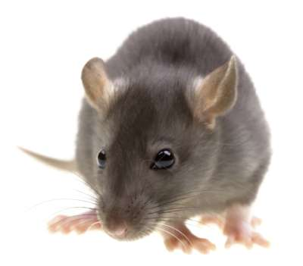
Fig. A
ADHD-mTBI mouse model
5 m/sec
Anesthesia with 2.5% isoflurane
Position: 1 mm anterior to bregma
4 mm lateral
Speed: 5 m/sec
Depth: 3 mm
Dwell time: 100 msec
Repetitions: 5 mTBI 24hr apart
9 mm
40 °
Daily mTBI for 5 consecutive days
-1
week
1day
2
week
4 week
P60
Up to P90
Pre
-
mTBI
Post
-
mTBI
Post
-
mTBI
Post
-
mTBI
Behaviors
Behaviors
Behaviors
Behaviors
Notes:
Even we set up the mouse on the stereotaxic, we did not operate the mouse skin, how should we describe the target position as 1.2 mm anterior to bregma; 4.2 mm lateral?

Slide 2
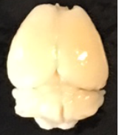
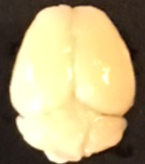
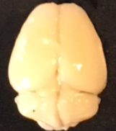
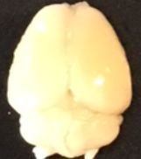
Fig. B
Histology
CT Shame PNE Sham
CT mTBI PNE mTBI
General brain structure has not changed

Slide 3

PNE Mouse Model
Unilateral closed head repetitive mTBI
Adult Male Control
40⁰
Adult Male PNE
Parameters:
Exposure time: Prenatal period- weaning
Groups: Control (water or saccharin); PNE (nicotine+ saccharin)
Parameters:
Anesthesia: Isoflurane 2.5%
Site: 1 mm anterior to bregma, and 4 mm lateral to the longitudinal midline
Depth: 3 mm from the surface of the skin
Velocity of impact: 5 meters/sec with a dwell time of 100 msec

Slide 4
Experimental Timeline
Adult Control/PNE
Sham Repetitive mTBI
TIME X??
24 HR
Behavioral analysis prior
to repetitive mTBI.
Y-maze, OBA, NOR, TST
Control and PNE mice split
into Sham or mTBI groups
Behavioral analysis following
repetitive mTBI.
Day 1
Y-maze
/TST
Day 4
OBA
/NOR
Day 14
Y-maze
/TST
Day 17
OBA
mTBI/Sham:
Day 1
Day 2
Day 3
Day 4
Day 5

Slide 5
A. B.
PNE Mouse Model
Unilateral closed head repetitive mTBI
Adult Male Control
40⁰
Adult Male PNE
Parameters:
Exposure time: Prenatal period- weaning
Groups: Control (water or saccharin); PNE (nicotine+ saccharin)
Parameters:
Anesthesia: Isoflurane 2.5%
Site: 1 mm anterior to bregma, and 4 mm lateral to the longitudinal midline
Depth: 3 mm from the surface of the skin
Velocity of impact: 5 meters/sec with a dwell time of 100 msec
C.
Experimental Timeline
Sham Repetitive mTBI
Adult Control/PNE
TIME X??
24 HR
Behavioral analysis prior
to repetitive mTBI.
Y-maze, OBA, NOR, TST
Control and PNE mice split
into Sham or mTBI groups
Behavioral analysis following
repetitive mTBI.
Day 1
Y-maze
/TST
Day 4
OBA
/NOR
Day 14
Y-maze
/TST
Day 17
OBA
mTBI/Sham:
Day 1
Day 2
Day 3
Day 4
Day 5

